Slide 1
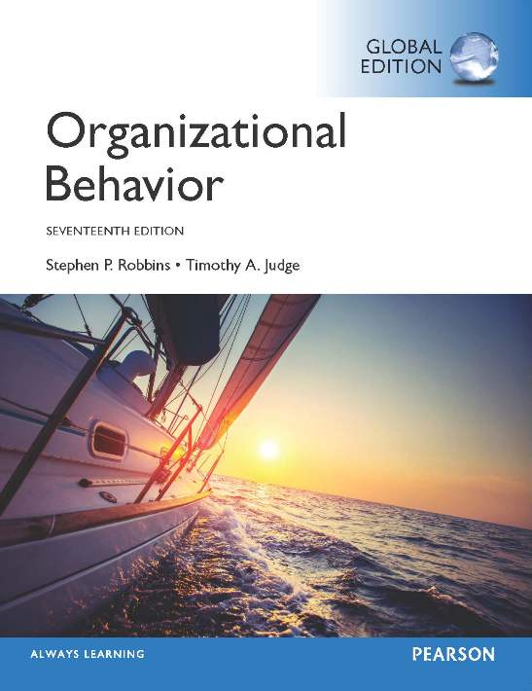
Notes:
Welcome to this Organizational Behavior course that uses the 17th edition of the textbook, Organizational Behavior by Robbins and Judge. This is considered among the most widely used OB textbooks in the world. Robbins and Judge are recognized as definitive aggregators of OB concepts, applications, and practices. The course and this book will provide you with a resource that will benefit you throughout your degree program and your professional life.

Slide 2
5
Personality
and
Values
Notes:
Chapter 5: Personality and Values

Slide 3
Learning Objectives
Describe personality, the way it is measured, and the factors that shape it.
Describe the strengths and weaknesses of the Myers-Briggs Type Indicator (MBTI) personality framework and the Big Five model.
Discuss how the concepts of core self-evaluation (CSE), self-monitoring, and proactive personality contribute to the understanding of personality.
Describe how the situation affects whether personality predicts behavior.
Contrast terminal and instrumental values.
Describe the differences between person-job fit and person-organization fit.
Compare Hofstede’s five value dimensions and the GLOBE framework.
Notes:
After studying this chapter, you should be able to:
Describe personality, the way it is measured, and the factors that shape it.
Describe the strengths and weaknesses of the Myers-Briggs Type Indicator personality framework and the Big Five model.
Discuss how the concepts of core self-evaluation (CSE), self-monitoring, and proactive personality contribute to the understanding of personality.
Describe how the situation affects whether personality predicts behavior.
Contrast terminal and instrumental values.
Describe the differences between person-job fit and person-organization fit.
Compare Hofstede’s five value dimensions and the GLOBE framework.

Slide 4

Describe Personality, the Way It Is Measured, and the Factors that Shape It
LO 1
Defining Personality
Personality is a dynamic concept describing the growth and development of a person’s whole psychological system.
The sum total of ways in which an individual reacts to and interacts with others.
Notes:
We begin by defining personality. Personality is a dynamic concept, meaning it is changing all the time. It describes the total of growth and development of a person’s whole psychological system. The text definition is that personality is the sum total of ways in which an individual reacts to and interacts with others.

Slide 5


Describe Personality, the Way It Is Measured, and the Factors that Shape It
LO 1
Measuring Personality
Managers need to know how to measure personality.
Personality tests are useful in hiring decisions and help managers forecast who is best for a job.
The most common means of measuring personality is through self-report surveys.
Notes:
One of the greatest challenges in the study of personality is its measurement. Managers need to know how to measure personality because accurately measuring personality gives managers an advantage in the recruitment and hiring processes. Typically, personality is measured using self-report surveys.
Research indicates our culture influences the way we rate ourselves. People in individualistic countries trend toward self-enhancement, while people in collectivist countries like Taiwan, China, and South Korea trend toward self-diminishment.
Observer-ratings surveys provide an independent assessment of personality. Here, a coworker or another observer does the rating.
Though the results of self-reports and observer-ratings surveys are strongly correlated, research suggests observer-ratings surveys predict job success more than self-ratings alone.
However, each can tell us something unique about an individual’s behavior, so a combination of self-reports and observer reports predicts performance better than any one type of information.

Slide 6




Describe Personality, the Way It Is Measured, and the Factors that Shape It
LO 1
Personality Determinants
Is personality the result of heredity or environment?
Heredity refers to those factors that were determined at conception.
The heredity approach argues that the ultimate explanation of an individual’s personality is the molecular structure of the genes, located in the chromosomes.
Notes:
An early argument centered on whether or not personality was the result of heredity or environment. Personality appears to be a result of both influences. Heredity refers to those factors that were determined at conception. The heredity approach argues that the ultimate explanation of an individual’s personality is the molecular structure of the genes, located in the chromosomes.

Slide 7


Describe Personality, the Way It Is Measured, and the Factors that Shape It
LO 1
Early research tried to identify and label enduring personality characteristics.
Shy, aggressive, submissive, lazy, ambitious, loyal, and timid.
These are personality traits.
Notes:
Popular characteristics include shy, aggressive, submissive, lazy, ambitious, loyal, and timid. These are personality traits. The more consistent the characteristic over time, and the more frequently it occurs in diverse situations, the more important the trait is in describing the individual.

Slide 8

Strengths and Weakness of the MBTI and Big Five Model
LO 2
The most widely used personality framework is the Myers-Briggs Type Indicator (MBTI).
Individuals are classified as:
Extroverted or Introverted (E or I)
Sensing or Intuitive (S or N)
Thinking or Feeling (T or F)
Perceiving or Judging (P or J)
INTJs are visionaries.
ESTJs are organizers.
ENTPs are conceptualizers.
INTJs are visionaries. They usually have original minds and great drive. They are characterized as skeptical, critical, independent, determined, and often stubborn
ESTJs are organizers. They are realistic, logical, analytical, decisive, and have a natural head for business or mechanics.
ENTPs are conceptualizers. They are innovative, individualistic, versatile, and attracted to entrepreneurial ideas. They tend to be resourceful in solving challenging problems but may neglect routine assignments.
Notes:
The most widely used personality framework is the Myers-Briggs Type Indicator (MBTI). Individuals are classified as Extroverted or Introverted (E or I), Sensing or Intuitive (S or N), Thinking or Feeling (T or F), and Perceiving or Judging (P or J). These classifications are then combined into sixteen personality types.
INTJs are visionaries. They usually have original minds and great drive. They are characterized as skeptical, critical, independent, determined, and often stubborn.
ESTJs are organizers. They are realistic, logical, analytical, decisive, and have a natural head for business or mechanics.
ENTPs are conceptualizers. They are innovative, individualistic, versatile, and attracted to entrepreneurial ideas. They tend to be resourceful in solving challenging problems but may neglect routine assignments.
MBTI is widely used. Some organizations using it include Apple Computer, AT&T, Citigroup, GE, and 3M.

Slide 9












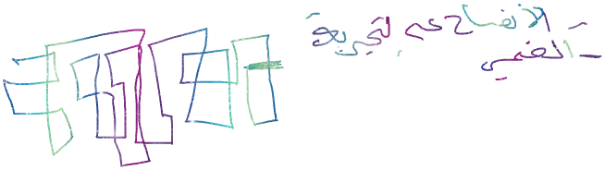






Strengths and Weakness of the MBTI and Big Five Model
LO 2
The Big Five Model
Extraversion
Agreeableness
Conscientiousness
Emotional stability
Openness to experience
Notes:
An impressive body of research supports that five basic dimensions underlie all other personality dimensions. The five basic dimensions are extraversion, agreeableness, conscientiousness, emotional stability, and openness to experience. Let’s look at each of these for a minute.
Extraversion is a comfort level with relationships. Extroverts tend to be gregarious, assertive, and sociable. Introverts tend to be reserved, timid, and quiet.
Agreeableness is an Individual’s propensity to defer to others. People who are high on agreeableness are cooperative, warm, and trusting. Low agreeableness is indicated by people who are cold, disagreeable, and antagonistic.
Conscientiousness is a measure of reliability. A highly conscientious person is responsible, organized, dependable, and persistent. Those who score low on this dimension are easily distracted, disorganized, and unreliable.
Emotional stability describes a person’s ability to withstand stress. People with positive emotional stability tend to be calm, self-confident, and secure. Those with high negative scores tend to be nervous, anxious, depressed, and insecure.
And lastly, openness to experience suggests the range of interests and fascination with novelty. Extremely open people are creative, curious, and artistically sensitive. Those at the other end of the openness category are conventional and find comfort in the familiar.

Slide 10
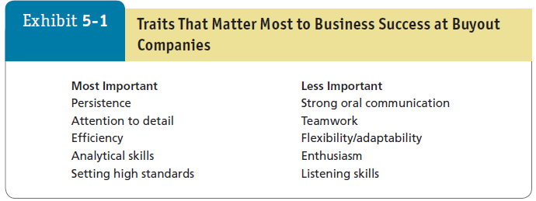




Strengths and Weakness of the MBTI and Big Five Model
LO 2
Notes:
Exhibit 5-1 shows the results of research on personality scores of CEO candidates. The study found that conscientiousness—in the form of persistence, attention to detail, and setting of high standards—was more important than other traits. These results attest to the importance of conscientiousness to organizational success. Although conscientiousness is the best predictor of job performance, other traits are also important.

Slide 11
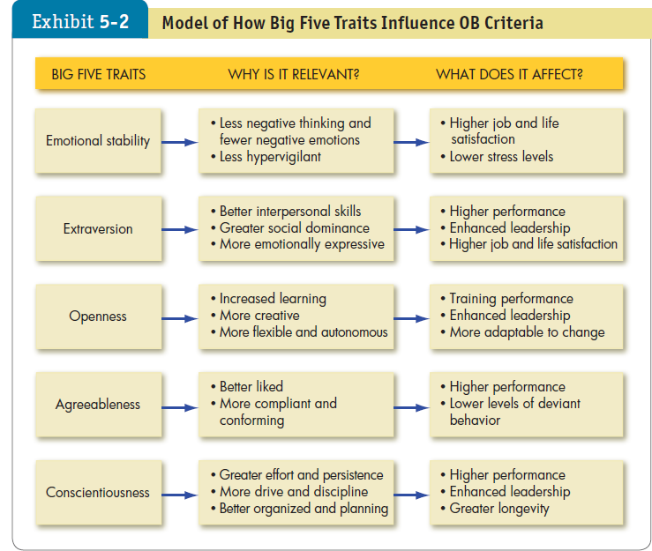

Strengths and Weakness of the MBTI and Big Five Model
LO 2
Notes:
All five traits also have other implications for work and for life. Let’s look at these one at a time. Exhibit 5-2 summarizes the points.
Of the Big Five traits, emotional stability is most strongly related to life satisfaction, job satisfaction, and low stress levels.
People with high emotional stability can adapt to unexpected or changing demands in the workplace.
Extraverts tend to perform better in jobs that require significant interpersonal interaction. Extraversion is a relatively strong predictor of leadership emergence in groups. One downside is that extraverts are more impulsive than introverts and may be more likely than introverts to lie during job interviews.
Individuals who score high on openness to experience are more likely to be effective leaders and are more comfortable with ambiguity. They cope better with organizational change and are more adaptable in changing contexts. Agreeable individuals are better liked than disagreeable people, which explains why they tend to do better in interpersonally-oriented jobs such as customer service.
They are also more compliant and rule abiding and less likely to get into accidents as a result. People who are agreeable are more satisfied in their jobs and contribute to organizational performance by engaging in citizenship behavior. They are also less likely to engage in organizational deviance.
One downside is that agreeableness is associated with lower levels of career success (especially earnings).
The five personality factors identified in the Big Five model appear in almost all cross-cultural studies.
These studies have included a wide variety of diverse cultures such as China, Israel, Germany, Japan, Spain, Nigeria, Norway, Pakistan, and the United States. Generally, the findings corroborate what has been found in U.S. research: of the Big Five traits, conscientiousness is the best predictor of job performance.

Slide 12
Strengths and Weakness of the MBTI and Big Five Model
LO 2
The Dark Triad Machiavellianism: the degree to which an individual is pragmatic, maintains emotional distance, and believes that ends can justify means.
Narcissism: the tendency to be arrogant, have a grandiose sense of self-importance, require excessive admiration, and have a sense of entitlement.
Psychopathy: the tendency for a lack of concern for others and a lack of guilt or remorse when their actions cause harm.
Notes:
The Dark Triad is a group of negative personality traits including Machiavellianism, narcissism, and psychopathy – all three of which have relevance for organizational behavior.
Machiavellianism is the degree to which an individual is pragmatic, maintains emotional distance, and believes that ends can justify means. Narcissism refers to the tendency to be arrogant, have a grandiose sense of self-importance, require excessive admiration, and have a sense of entitlement. And psychopathy is the tendency for a lack of concern for others and a lack of guilt or remorse when their actions cause harm.

Slide 13

Strengths and Weakness of the MBTI and Big Five Model
LO 2
An emerging framework to study dark side traits:
First, antisocial people are indifferent and callous toward others.
Second, borderline people have low self-esteem and high uncertainty.
Notes:
The Dark Triad is a helpful framework for studying the three dominant dark-side traits in current personality research, and researchers are exploring other traits as well.
One emerging framework incorporates five additional aberrant compound traits based on the Big Five.
First, antisocial people are indifferent and callous toward others.
Second, borderline people have low self-esteem and high uncertainty.

Slide 14



Strengths and Weakness of the MBTI and Big Five Model
LO 2
Third, schizotypal individuals are eccentric and disorganized.
Fourth, obsessive compulsive people are perfectionists and can be stubborn, yet they attend to details, carry a strong work ethic, and may be motivated by achievement.
Fifth, avoidant individuals feel inadequate and hate criticism.
Notes:
Third, schizotypal individuals are eccentric and disorganized.
Fourth, obsessive compulsive people are perfectionists and can be stubborn, yet they attend to details, carry a strong work ethic, and may be motivated by achievement.
Fifth, avoidant individuals feel inadequate and hate criticism.

Slide 15


CSE, Self-Monitoring, and Proactive Personality
LO 3
Other Personality Traits Relevant to OB
Core Self-Evaluation: bottom line conclusions individuals have about their capabilities, competence, and worth as a person.
Self-Monitoring: measures an individual’s ability to adjust his or her behavior to external, situational factors.
Proactive Personality: people who identify opportunities, show initiative, take action, and persevere until meaningful change occurs.
Notes:
Some other personality traits relevant to OB include core self-evaluation, self-monitoring, and proactive personality.
People who have a positive core self-evaluation see themselves as effective, capable, and in control. People who have a negative core self-evaluation tend to dislike themselves.
Self-monitoring refers to an individual’s ability to adjust his or her behavior to external, situational factors. Individuals high in self-monitoring show considerable adaptability. They are highly sensitive to external cues, can behave differently in different situations, and are capable of presenting striking contradictions between their public persona and their private selves.
An individual with a proactive personality actively takes the initiative to improve his or her current circumstances. These individuals identify opportunities, show initiative, take action, and persevere.

Slide 16
The Situation, Personality, and Behavior
LO 4
Situation strength theory: indicates that the way personality translates into behavior depends on the strength of the situation.
The degree to which norms, cues, or standards dictate appropriate behavior.
Clarity
Consistency
Constraints
Consequences
Notes:
Research shows that the effect of a particular trait on organizational behavior depends on the situation. Two theoretical frameworks that can help explain this are the situation strength theory and trait activation theory.
Situation strength in an organization can be analyzed in terms of:
Clarity, or the degree to which cues about work duties and responsibilities are available and clear.
Consistency, or the extent to which cues regarding work duties and responsibilities are compatible with one another.
Constraints, or the extent to which individuals’ freedom to decide or act is limited by forces outside their control.
Consequences, or the degree to which decisions or actions have important implications for the organization or its members, clients, supplies, and so on.

Slide 17
Clarity, or the degree to which cues about work duties and responsibilities are available and clear.
Consistency, or the extent to which cues regarding work duties and responsibilities are compatible with one another.
Constraints, or the extent to which individuals’ freedom to decide or act is limited by forces outside their control.
Consequences, or the degree to which decisions or actions have important implications for the organization or its members, clients, supplies, and so on.

Slide 18
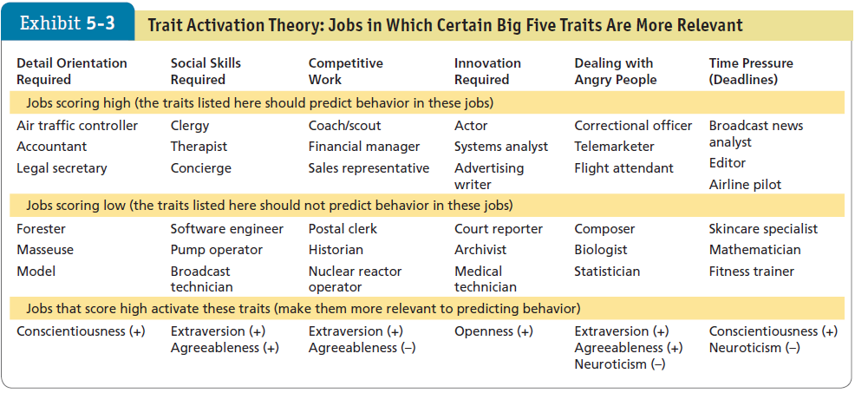
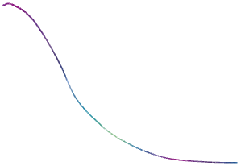

The Situation, Personality, and Behavior
LO 4
Notes:
Trait activation theory predicts that some situations, events, or interventions “activate” a trait more than others. Exhibit 5-3, shown here, provides specific examples of this theory.

Slide 19






Contrast Terminal and Instrumental Values
LO 5
Values: basic convictions about what is right, good, or desirable.
Value system: ranks values in terms of intensity.
The Importance and Organization of Values
Values:
Lay the foundation for understanding of attitudes and motivation.
Influence attitudes and behaviors.
Notes:
Values represent basic convictions that a person has about what is right, good, or desirable. Values have both content and intensity attributes, and have the tendency to be stable and enduring. An individual’s set of values ranked in terms of intensity is considered the person’s value system. Values lay the foundation for our understanding of attitudes and motivation and generally influence attitudes and behaviors.

Slide 20
Contrast Terminal and Instrumental Values
LO 5
Terminal vs. Instrumental Values
Terminal values: desirable end-states of existence.
Instrumental values: preferred modes of behavior or means of achieving terminal values.
Notes:
A specific mode of conduct or end-state of existence is personally or socially preferable to an opposite or converse mode of conduct or end-state of existence. Terminal values refer to desirable end-states of existence. These are the goals that a person would like to achieve during his or her lifetime. Instrumental values refer to preferable modes of behavior, that is, the means of achieving the terminal values.

Slide 21
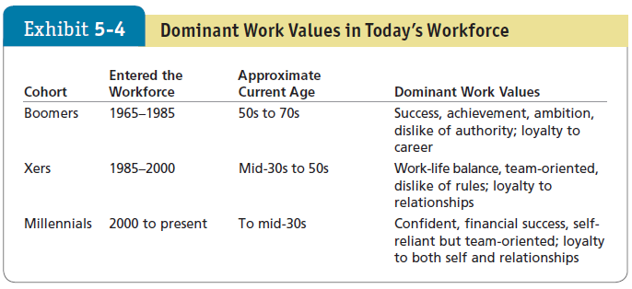





Contrast Terminal and Instrumental Values
LO 5
Notes:
Exhibit 5-4 shows that different generations hold different work values. Boomers (Baby Boomers) entered the workforce during the 1960s through the mid-1980s. Xers (Generation Xers) entered the workforce beginning in the mid-1980s. The most recent entrants to the workforce, are the Millennials. Though it is fascinating to think about generational values, remember that these classifications lack solid research support. Generational classifications may help us understand our own and other generations better, but we must also appreciate their limits.

Slide 22
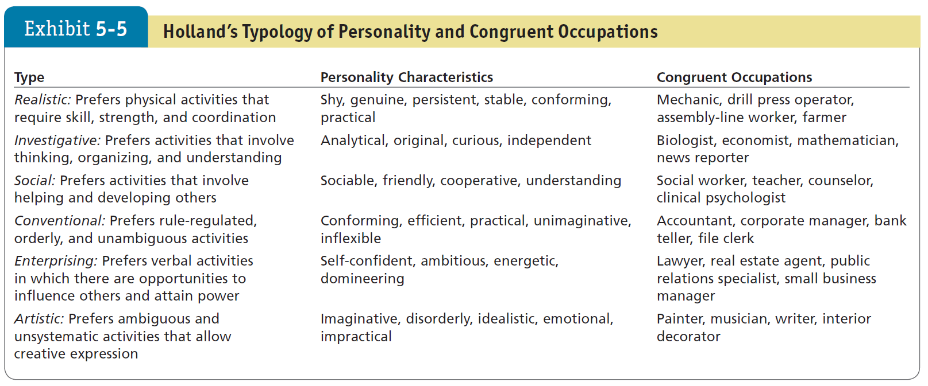


Person-Job Fit vs. Person-Organization Fit
LO 6
Notes:
The concept of Person-Job Fit is best articulated in John Holland’s personality-job fit theory as shown in Exhibit 5-5. Holland presents six personality types and proposes that satisfaction and the propensity to leave a job depends on the degree to which individuals successfully match their personalities to an occupational environment. He identifies six personality types: realistic, investigative, social, conventional, enterprising, and artistic.

Slide 23

Person-Job Fit vs. Person-Organization Fit
LO 6
Person-Organization Fit
People high on extraversion fit well with aggressive and team-oriented cultures.
People high on agreeableness match up better with a supportive organizational climate than one focused on aggressiveness.
People high on openness to experience fit better in organizations that emphasize innovation rather than standardization.
Notes:
The Person-Organization Fit is most important for an organization facing a dynamic and changing environment. Such organizations require employees who are able to readily change tasks and move fluidly between teams. It argues that people leave jobs that are not matched with their personalities.
Using the Big Five terminology, for instance, we could expect that people high on extraversion fit well with aggressive and team-oriented cultures, that people high on agreeableness match up better with a supportive organizational climate than one focused on aggressiveness, and that people high on openness to experience fit better in organizations that emphasize innovation rather than standardization. Research on person-organization fit has also looked at whether people’s values match the organization’s culture. This match predicts job satisfaction, commitment to the organization, and low turnover.

Slide 24

Person-Job Fit vs. Person-Organization Fit
LO 6
Other Dimensions of Fit
Although person-job fit and person-organization fit are considered the most salient dimensions for workplace outcomes, other avenues of fit are worth examining.
Person-group fit
Person-supervisor fit
Notes:
Although person-job fit and person-organization fit are considered the most salient dimensions for workplace outcomes, other avenues of fit are worth examining.
These include person-group fit and person-supervisor fit.
Person-group fit is important in team settings, where the dynamics of team interactions significantly affect work outcomes.
Person-supervisor fit has become an important area of research since poor fit in this dimension can lead to lower job satisfaction and reduced performance.

Slide 25





Hofstede’s Five Value Dimensions and GLOBE
LO 7
Hofstede’s Framework
Power distance
Individualism versus collectivism
Masculinity versus femininity
Uncertainty avoidance
Long-term versus short-term orientation
Notes:
Hofstede’s framework for assessing cultures suggests five value dimensions of national culture.
Power distance: is the degree to which people in a country accept that power in institutions and organizations is distributed unequally.
Individualism versus collectivism: individualism is the degree to which people in a country prefer to act as individuals rather than as members of groups. Collectivism emphasizes a tight social framework in which people expect others in groups in which they are a part to look after them and protect them.
Masculinity versus femininity: masculinity is the degree to which values such as the acquisition of money and material goods prevail. Femininity is the degree to which people value relationships and show sensitivity and concern for others.
Uncertainty avoidance: is the degree to which people in a country prefer structured over unstructured situations.
Long-term versus short-term orientation: long-term orientations look to the future and value thrift and persistence. Short-term orientation values the here and now; they accept change more readily and don’t see commitments as impediments to change.

Slide 26




Hofstede’s Five Value Dimensions and GLOBE
LO 7
The GLOBE Framework for Assessing Culture
The Global Leadership and Organizational Behavior Effectiveness (GLOBE) research program updated Hofstede’s research.
Data from 825 organizations and 62 countries.
Used variables similar to Hofstede’s.
Added some news ones.
Notes:
The Global Leadership and Organizational Behavior Effectiveness (GLOBE) program began updating Hofstede’s research using data from 825 organizations and 62 countries. The variables studied are similar to Hofstede’s, with some additional ones as well. For example, performance orientation is the degree to which a society encourages and rewards group members for performance improvement and excellence, and humane orientation is the degree to which a society rewards individuals for being altruistic, generous, and kind to others.

Slide 27
Implications for Managers
Consider screening job candidates for high conscientiousness—as well as the other Big Five traits—depending on the criteria your organization finds most important. Other aspects, such as core self-evaluation or narcissism, may be relevant in certain situations.
Although the MBTI has faults, you can use it for training and development; to help employees better understand each other, open up communication in work groups, and possibly reduce conflicts.
Notes:
Personality matters to organizational behavior. It doesn’t explain all behavior, but it sets the stage. Emerging theory and research reveal how personality matters more in some situations than others. The Big Five has been a particularly important advancement, though the Dark Triad and other traits matter as well.
Consider screening job candidates for high conscientiousness—as well as the other Big Five traits—depending on the criteria your organization finds most important. Other aspects, such as core self-evaluation or narcissism, may be relevant in certain situations.
Although the MBTI has faults, you can use it for training and development; to help employees better understand each other, open up communication in work groups, and possibly reduce conflicts.

Slide 28
Implications for Managers
Evaluate jobs, work groups, and your organization to determine the optimal personality fit.
Take into account employees' situational factors when evaluating their observable personality traits, and lower the situation strength, to better ascertain personality characteristics.
The more you consider people’s different cultures, the better you will be able to determine their work behavior and create a positive organizational climate that performs well.
Notes:
Evaluate jobs, work groups, and your organization to determine the optimal personality fit.
Take into account employees' situational factors when evaluating their observable personality traits, and lower the situation strength, to better ascertain personality characteristics.
The more you consider people’s different cultures, the better you will be able to determine their work behavior and create a positive organizational climate that performs well.

